Slide 1
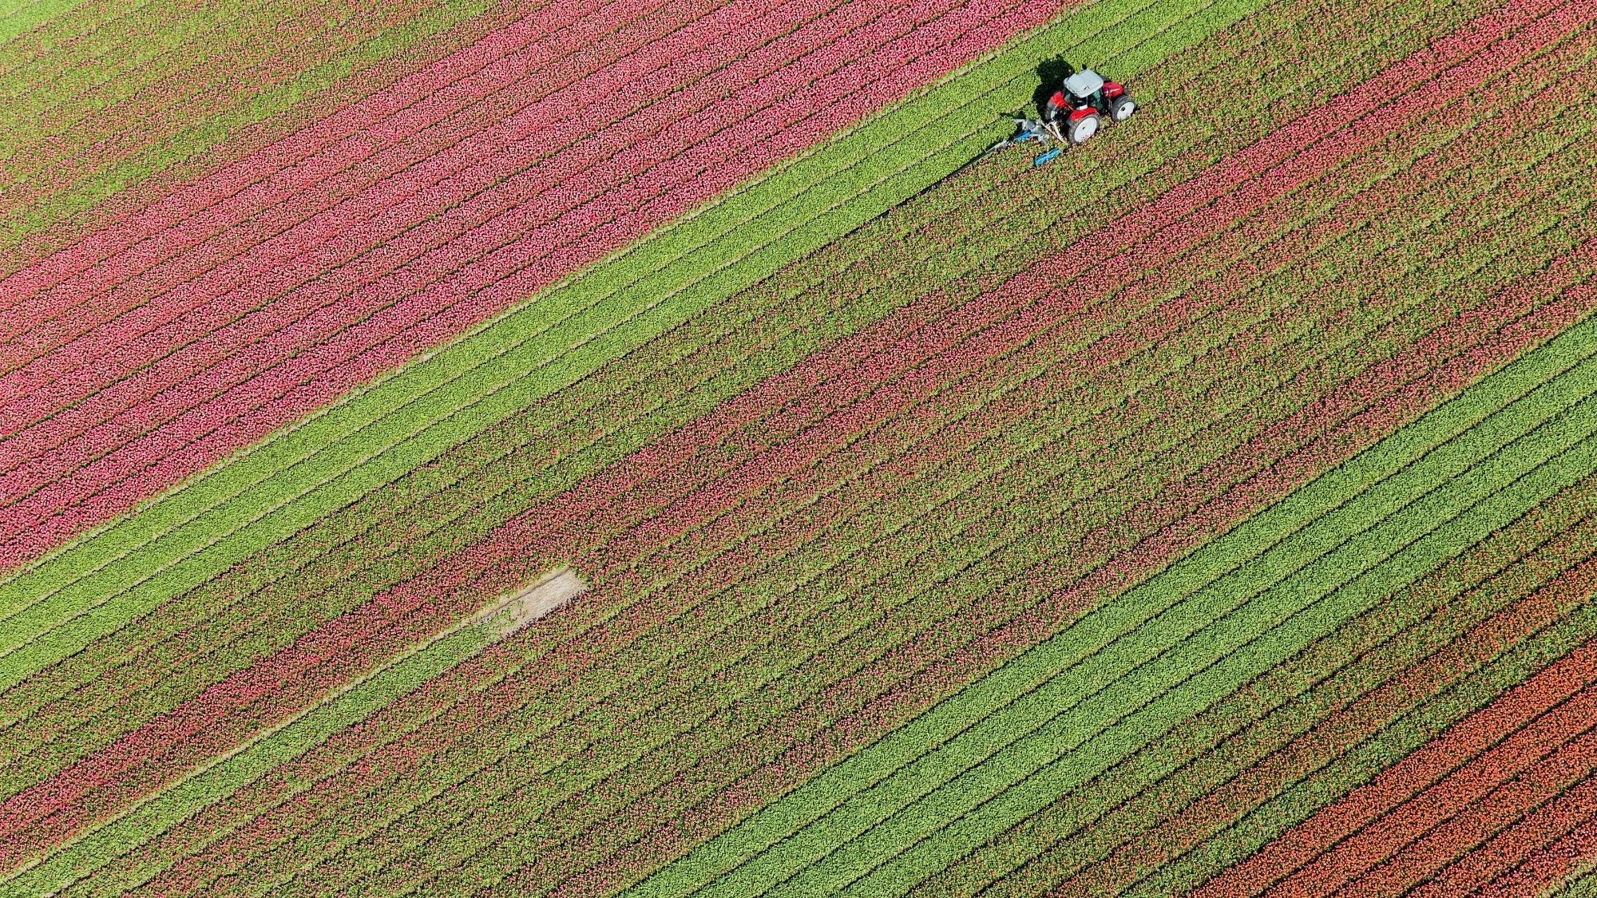
HungerFree Alliance Mission Statement: ”To reduce global hunger by providing sustainable food solutions, raising awareness, and ensuring equitable access to nutritious meals for underserved communities.”

Slide 2
Overview
Introduction (AM)
Data Gathering Process (AM)
Database Design Overview (TH)
Fact and Dimension Tables (TH)
Database Storage and Management (AM)
Data Usage and Analysis (AM)
Visualizations (TH + AM)
Conclusion & Next Steps (TH)
Notes:
Here’s a breakdown of today’s presentation — we’ll walk through how we generated our data, how our database is structured and used, and how we used it to drive real analysis and forecasting.

Slide 3
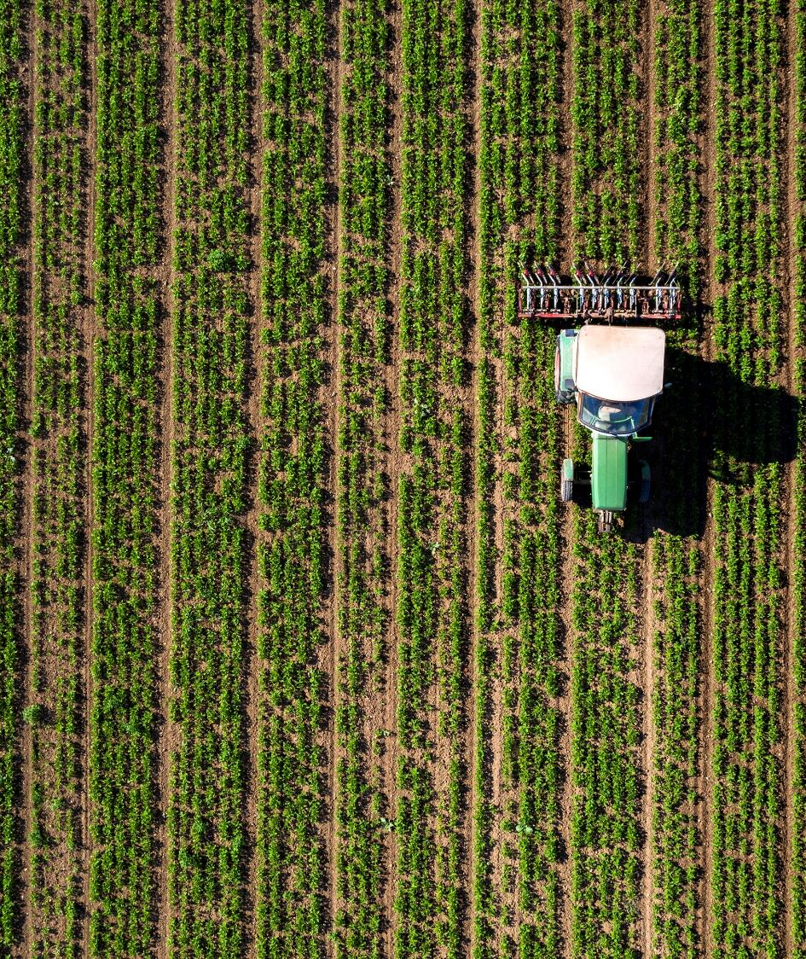
Introduction
HungerFree Alliance is a nonprofit food security organization.
It partners with grocery stores, farms, and schools to redirect surplus food to underserved communities.
Simulates a full backend system for tracking donations, distributions, and predicting future food needs.
AM
Notes:
HungerFree Alliance is a nonprofit that partners with schools, local grocers, and farms to deliver rescued or donated food to high-risk communities. We built a full backend system to help them track donations, manage distributions, and even predict future food needs.

Slide 4
Data Gathering Process
Randomly generated: volunteers, donors, communities, food
Modeled from data.gov and real food access data
Ensured seasonality, delivery trends
AM
Notes:
We generated realistic data sets from scratch using Python — with fields like donor amounts, volunteer hours, food shelf life, and community malnutrition rates. This helped us simulate a real-world nonprofit backend system.

Slide 5
Database Design Overview
Designed a Star Schema structure optimized for efficient querying, analytics, and reporting.
Utilized MySQL for local data management and storage.
Included multiple dimension and fact tables to support detailed analysis across community metrics, food distribution, donations, and volunteer activity.
Integrated state- and community-level access metrics for reporting.
Supported both real and synthetic data for testing, visualization, and predictive modeling.
TH
Notes:
Our database uses a star schema . This allows fast, organized querying by linking a central fact table with reference dimensions. This structure is standard in business intelligence systems.

Slide 6

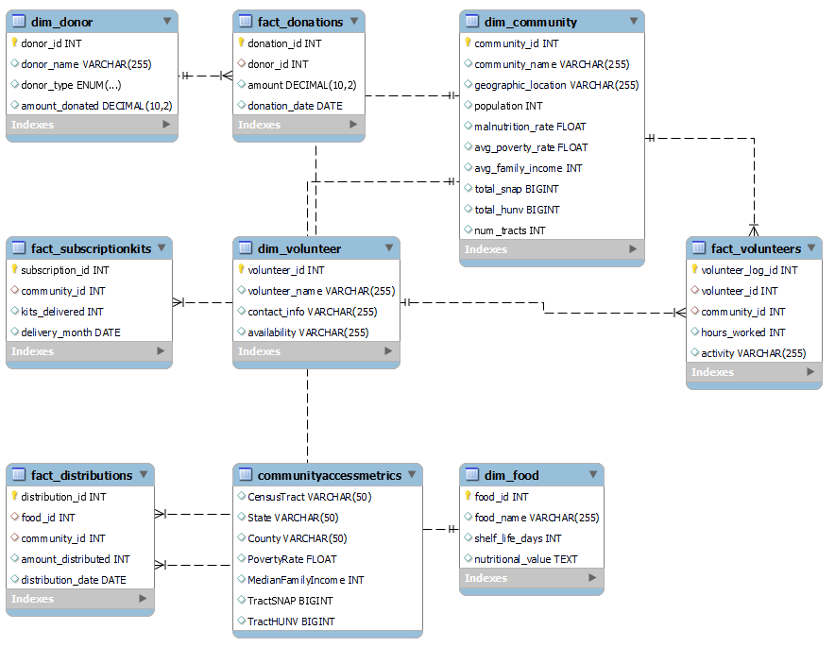
Fact and Dimension Tables
Dimension Tables
dim_food
dim_community
dim_volunteer
dim_donor
Fact Tables
fact_subscriptionkits
fact_volunteers
fact_donations
fact_distributions
Additional Table
community access metrics: This table is linked to dim_community for community access metrics but is not a core fact or dimension table.
TH
Notes:
Our dimension tables hold clean, reusable information — like community profiles and donor names. Our fact tables record events like donations and food distributions, allowing us to analyze activity over time.

Slide 7
Database Storage
Stored locally using MySQL Workbench
Accessed via Python with mysql.connector
Star schema format
SQL dump backups
Password-protected environment
Database Management
Used Python scripts for cleaning and loading
Removed duplicates and standardized data
Foreign key constraints maintained
Admin-only access
Manual ETL: Extract → Transform → Load
AM
Notes:
Data management followed a basic ETL pipeline concept. Creating, cleaning, and validating realistic data before secure loading into MySQL tables, ensuring relational consistency and clean analysis-ready structure.

Slide 8
Data Usage and Analysis
Track total donations by donor, identify seasonal trends in distributions, forecast future demand.
Predicted Subscription Meal Kit Demand:
SELECT
DATE_FORMAT(delivery_month, '%Y-%m') AS delivery_month,
SUM(kits_delivered) AS total_kits
FROM Fact_SubscriptionKits
GROUP BY delivery_month
ORDER BY delivery_month
Total Food Distributed over 6 Months:
SELECT DATE_FORMAT(distribution_date, '%Y-%m') AS month, SUM(amount_distributed) AS total_distributed
FROM Fact_Distributions
GROUP BY month
ORDER BY month
Visualize SNAP Benefits Usage by State:
SELECT State, SUM(TractSNAP) AS total_snap
FROM CommunityAccessMetrics
GROUP BY State
ORDER BY total_snap DESC
LIMIT 10
AM

Slide 9
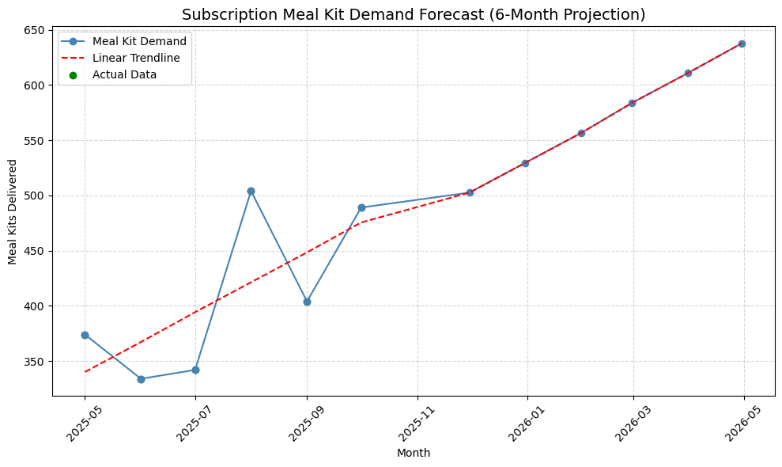
Predicted Subscription Meal Kit Demand
AM
Notes:
Each of these visualizations answers a real operational question — who funds us, when food demand peaks, and how many meals we’ll need to prepare in the future.

Slide 10
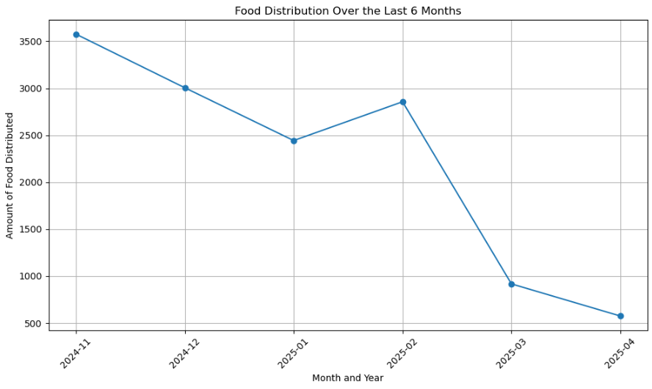
Visualization 1
TH
Notes:
Each of these visualizations answers a real operational question — who funds us, when food demand peaks, and how many meals we’ll need to prepare in the future.

Slide 11
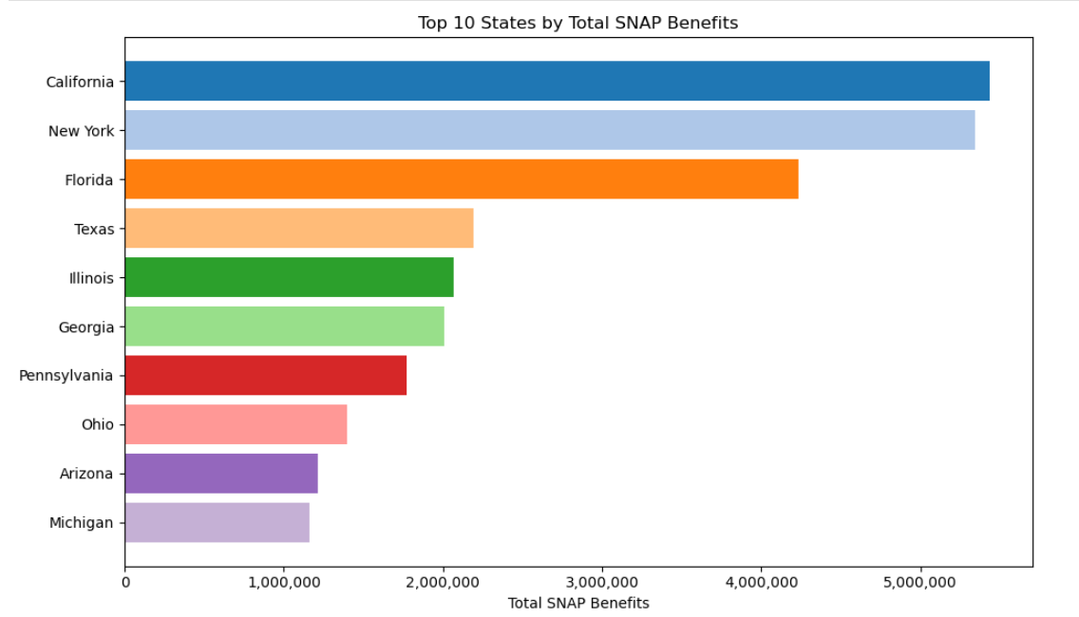
Visualization 2
TH
Notes:
Each of these visualizations answers a real operational question — who funds us, when food demand peaks, and how many meals we’ll need to prepare in the future.

Slide 12
Conclusion
Next Steps
Supports Food Distribution: Our database schema is designed to streamline and enhance our food distribution processes, tracking meal kits, donations, and volunteer hours.
Predicts Subscription Meal Kit Demand: The integrated data models help us anticipate demand patterns, optimizing meal kit delivery to communities in need.
Mobile App Integration: Explore integrating a mobile application to track real-time food requests and coordinate volunteer availability, making our operations more responsive and accessible.
TH
Notes:
This system can grow to support real-time food alerts, health tracking, and app-based inventory. With predictive models, nonprofits like HungerFree Alliance can make smarter, faster decisions that impact lives.

Slide 13
References
Data Source: USDA Economic Research Service – Food Access Research Atlas (2019).
https://www.ers.usda.gov/data-products/food-access-research-atlas/download-the-data

Slide 14
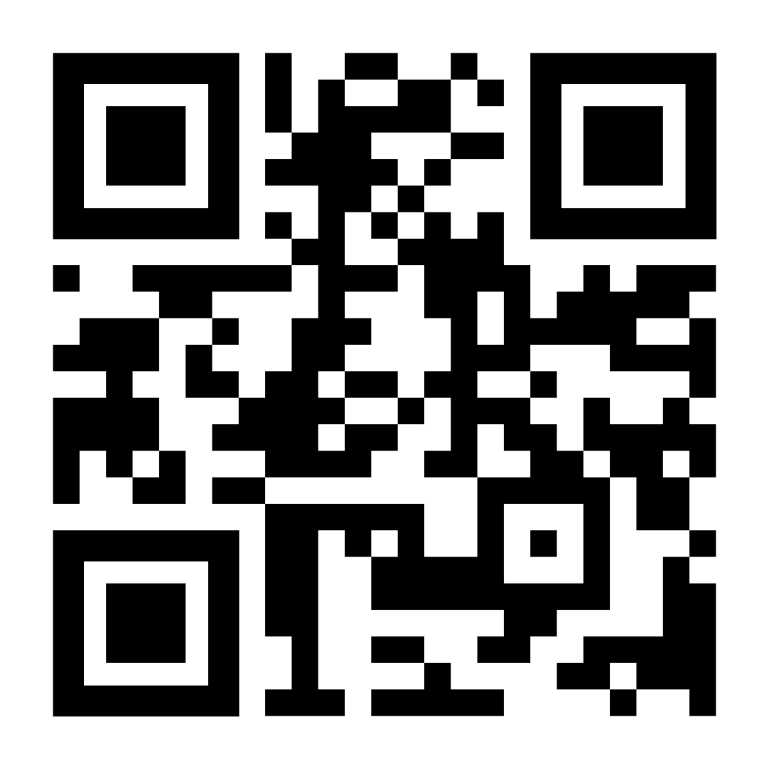
Thank You!!

